Slide 1
Great Eight
Ceramics Project

Slide 2
Order for today:
Introduction to clay (you might wanna take notes)
Tour of the ceramics room
Making a hump mold for new project!
Kahoot next day

Slide 3
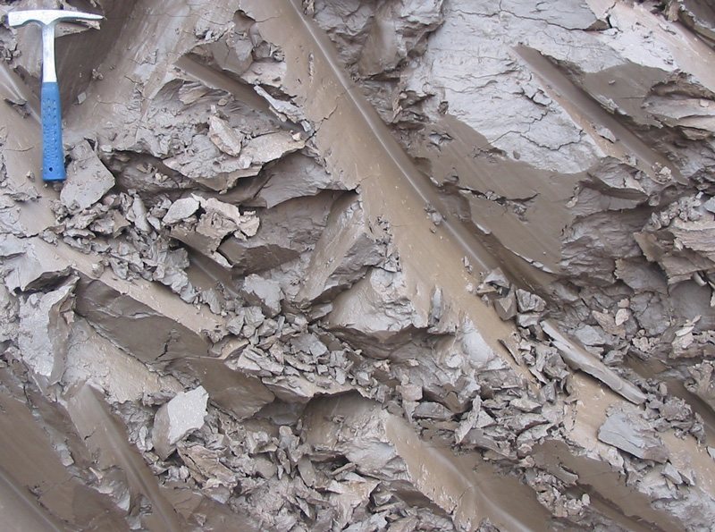
Using Clay
Clay is a mixture of different types of very fine dirt, sand and sediment. Manufactured clay is carefully made so that it can fire at the right temperature with the same results every time. It is possible to use clay straight from the ground, but it is not easy to control.

Slide 4
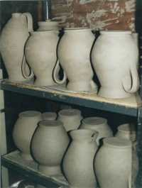
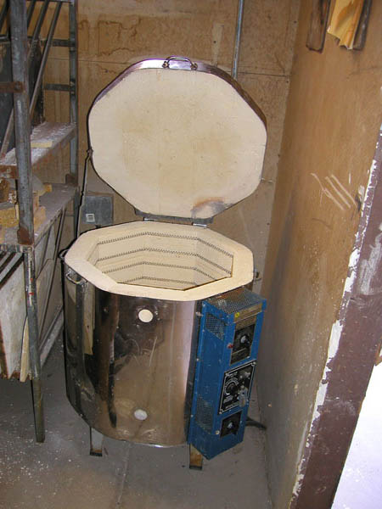
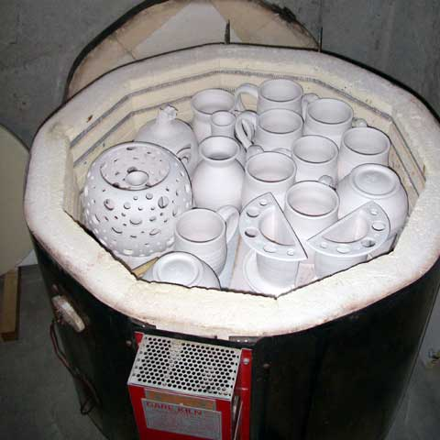
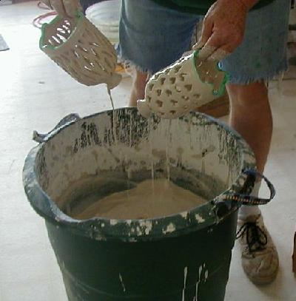
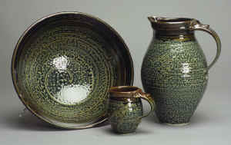
New Words
Bisqueware – ceramics that have been fired once.
Glaze – a chemical coating that turns to glass when fired.
Kiln – a special oven for ceramics
Greenware
To fire – to heat ceramics to a high temperature in a kiln.

Slide 5
Stages of Clay
Wet clay is made into objects.
When it dries, it is called Greenware.
Greenware is then Bisque fired in a kiln. (Firing 1)
When it has been fired once, it is called Bisqueware.
Bisqueware is then covered with glaze.
The glazed work is then fired again (Firing 2) in a glaze firing where the glaze vitrifies (turns to glass.)

Slide 6
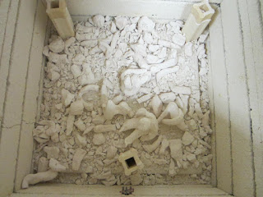
Careful Planning
Know what you are going to make.
Know how you will make it.
Ceramics projects must be planned because they will be fired in a kiln. If they are made incorrectly, they may explode. This will break other students’ work and possibly damage the kiln.

Slide 7
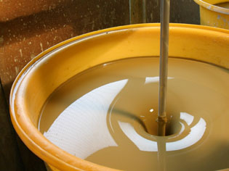
The Three RULES of Clay
Don’t make anything thicker than your thumb – it might explode!
Don’t make any hollow sections or bubbles unless there is a hole to let air out. It will also explode.
Use slip when joining pieces of clay together. It’s like glue!

Slide 8
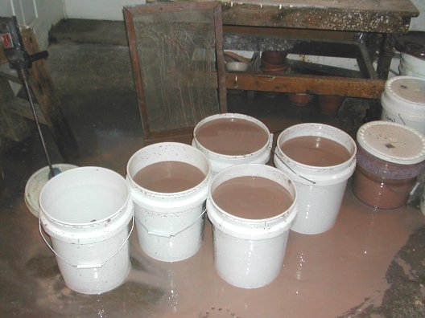
Cleaning up
If clay goes down the sink, it will clog up.
First scrub and rinse all tools and your hands in a water bucket – no matter how muddy the water looks.
Second, rinse all tools and your hands in clean water. Remember to wash your hands with soap before eating anything.
All surfaces must be washed clean with water and a sponge.
Dirty water is NOT dumped into the sink; put it in the clay slurry recycling bin - match the clay colour.

Slide 9
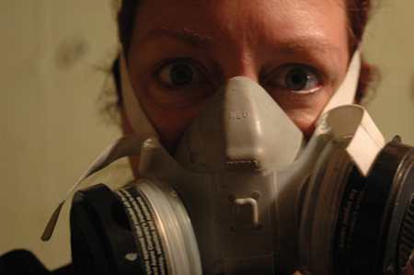
Health and Safety
When it is wet, clay is harmless.
When clay dries, it turns to dust. Breathing the dust can be harmful. All clay must be washed off surfaces to keep everyone safe.
Work on a canvas bat in order to reduce dust, and to keep the clay from sticking to the table.
Keep a container of water on your table to keep your hands wet.

Slide 10
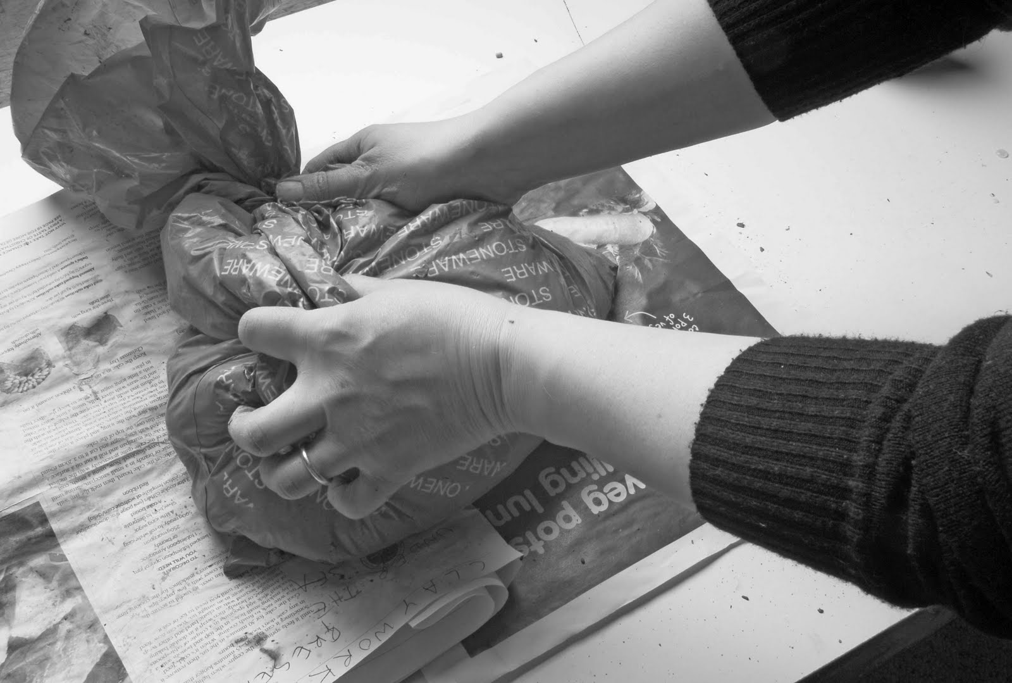
Wrapping your work
Your work must be carefully wrapped to ensure it is moist when you come back to work on it.
Use damp (NOT WET!) paper towel to cover your work.
Place your work in a plastic bag (with no tears or holes) and seal it up.
Write your name on the bag, and put it on the correct shelf.

Slide 11
Hump Molds
A hump mold is used to shape clay over its surface. Once the clay dries, it will retain the shape.

Slide 12
Scrunch up newspaper

