Slide 1
GUIDED BY VOICES
Compilation Album Design
RESEARCH AND DEVELOPMENT

Slide 2
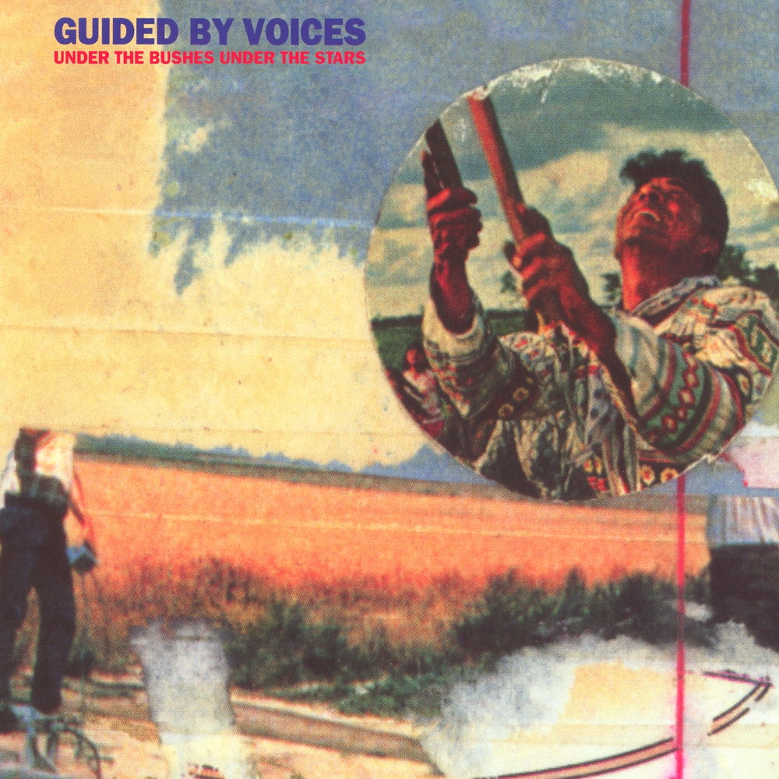
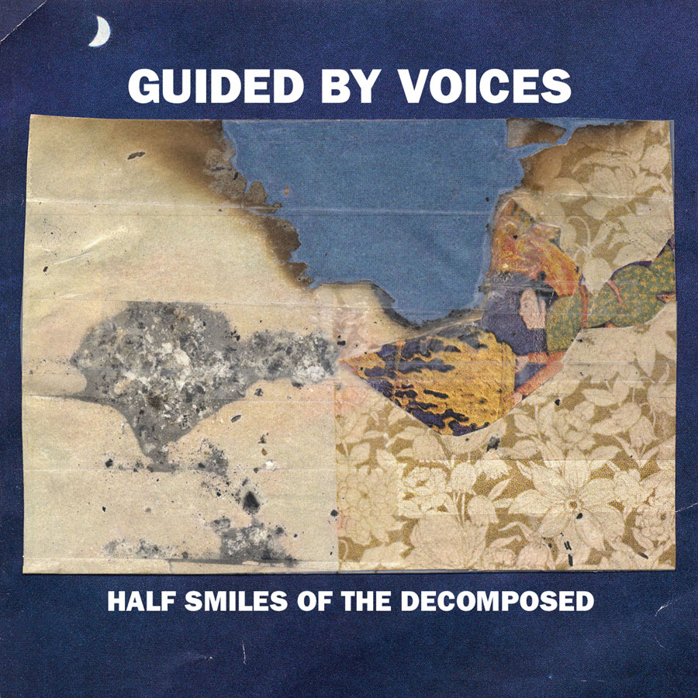
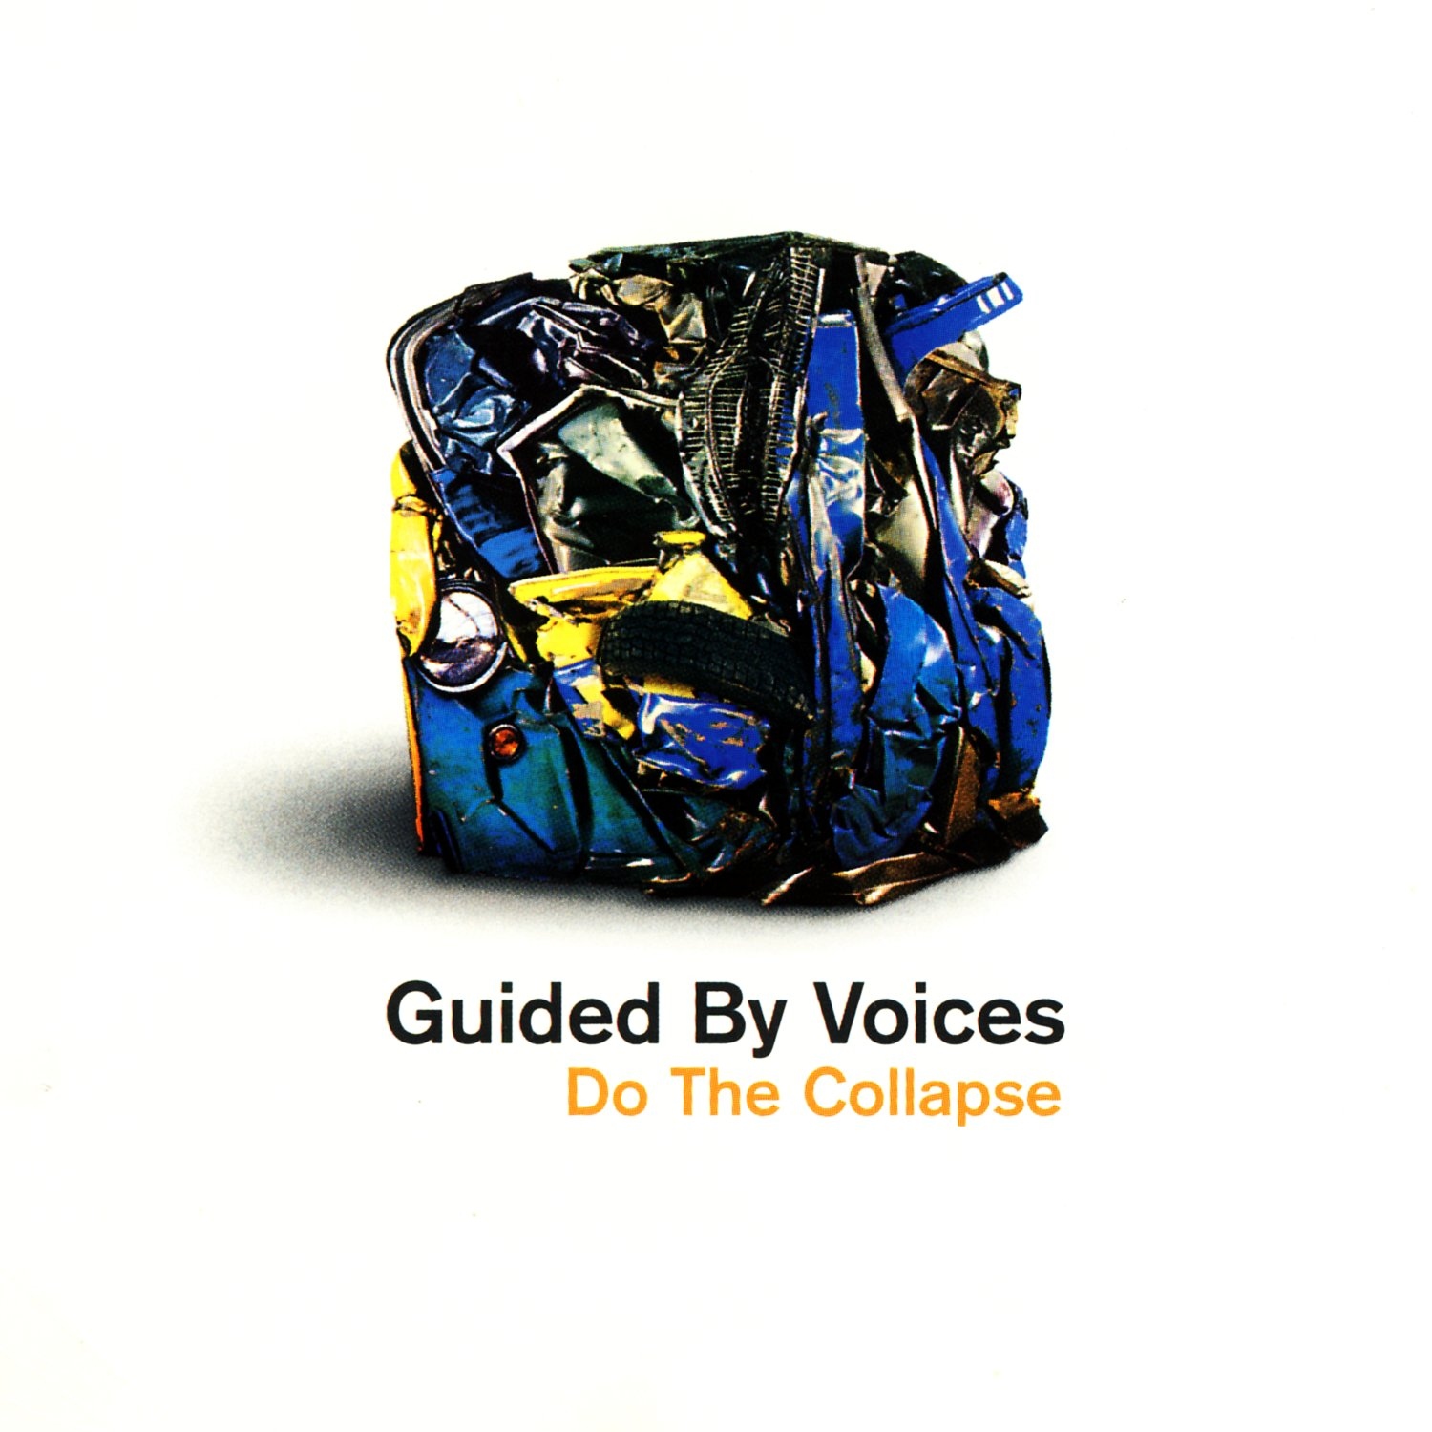
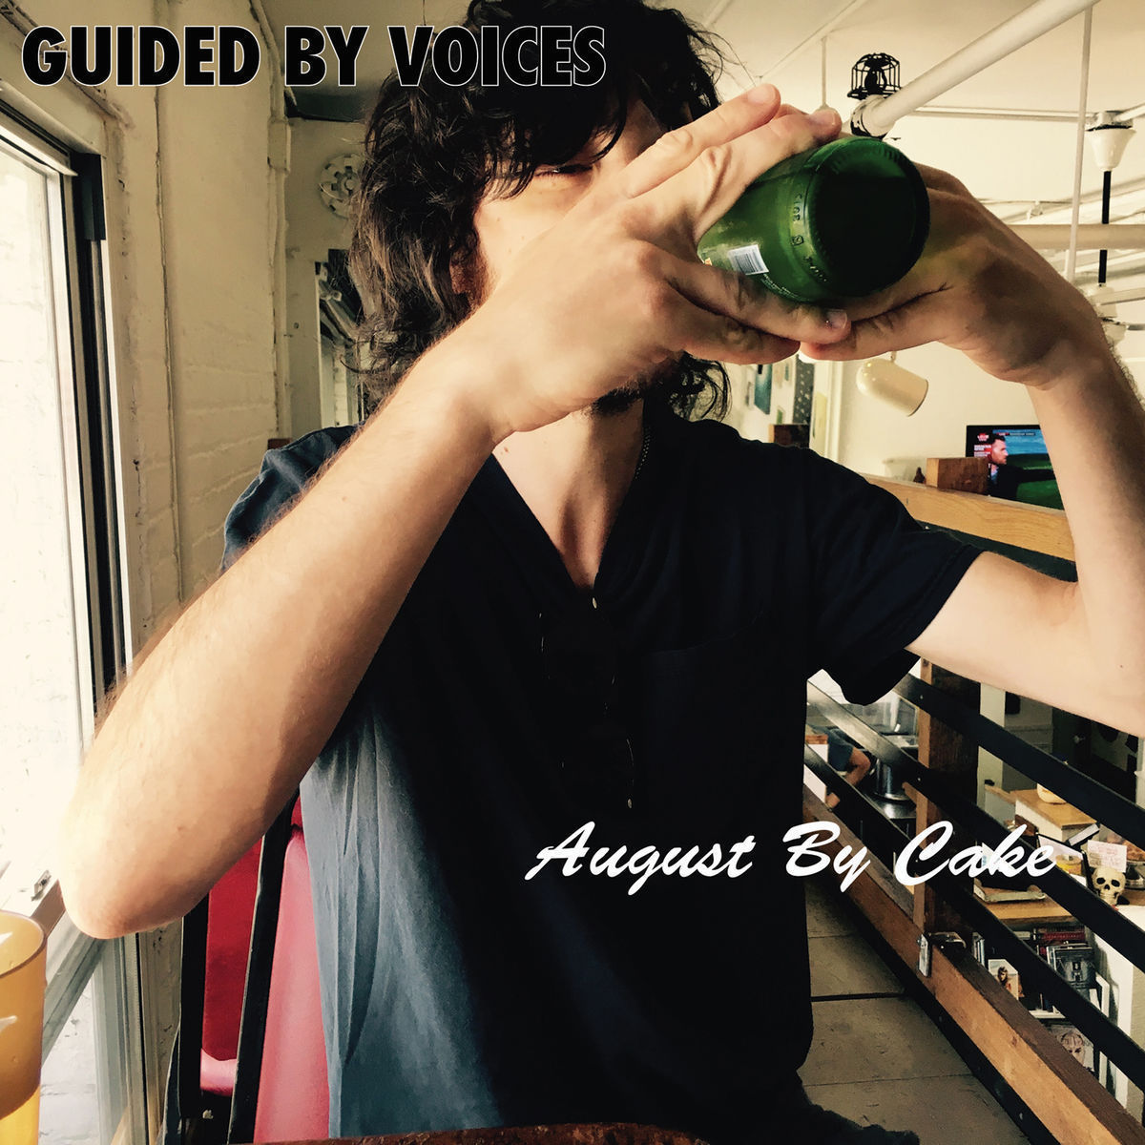
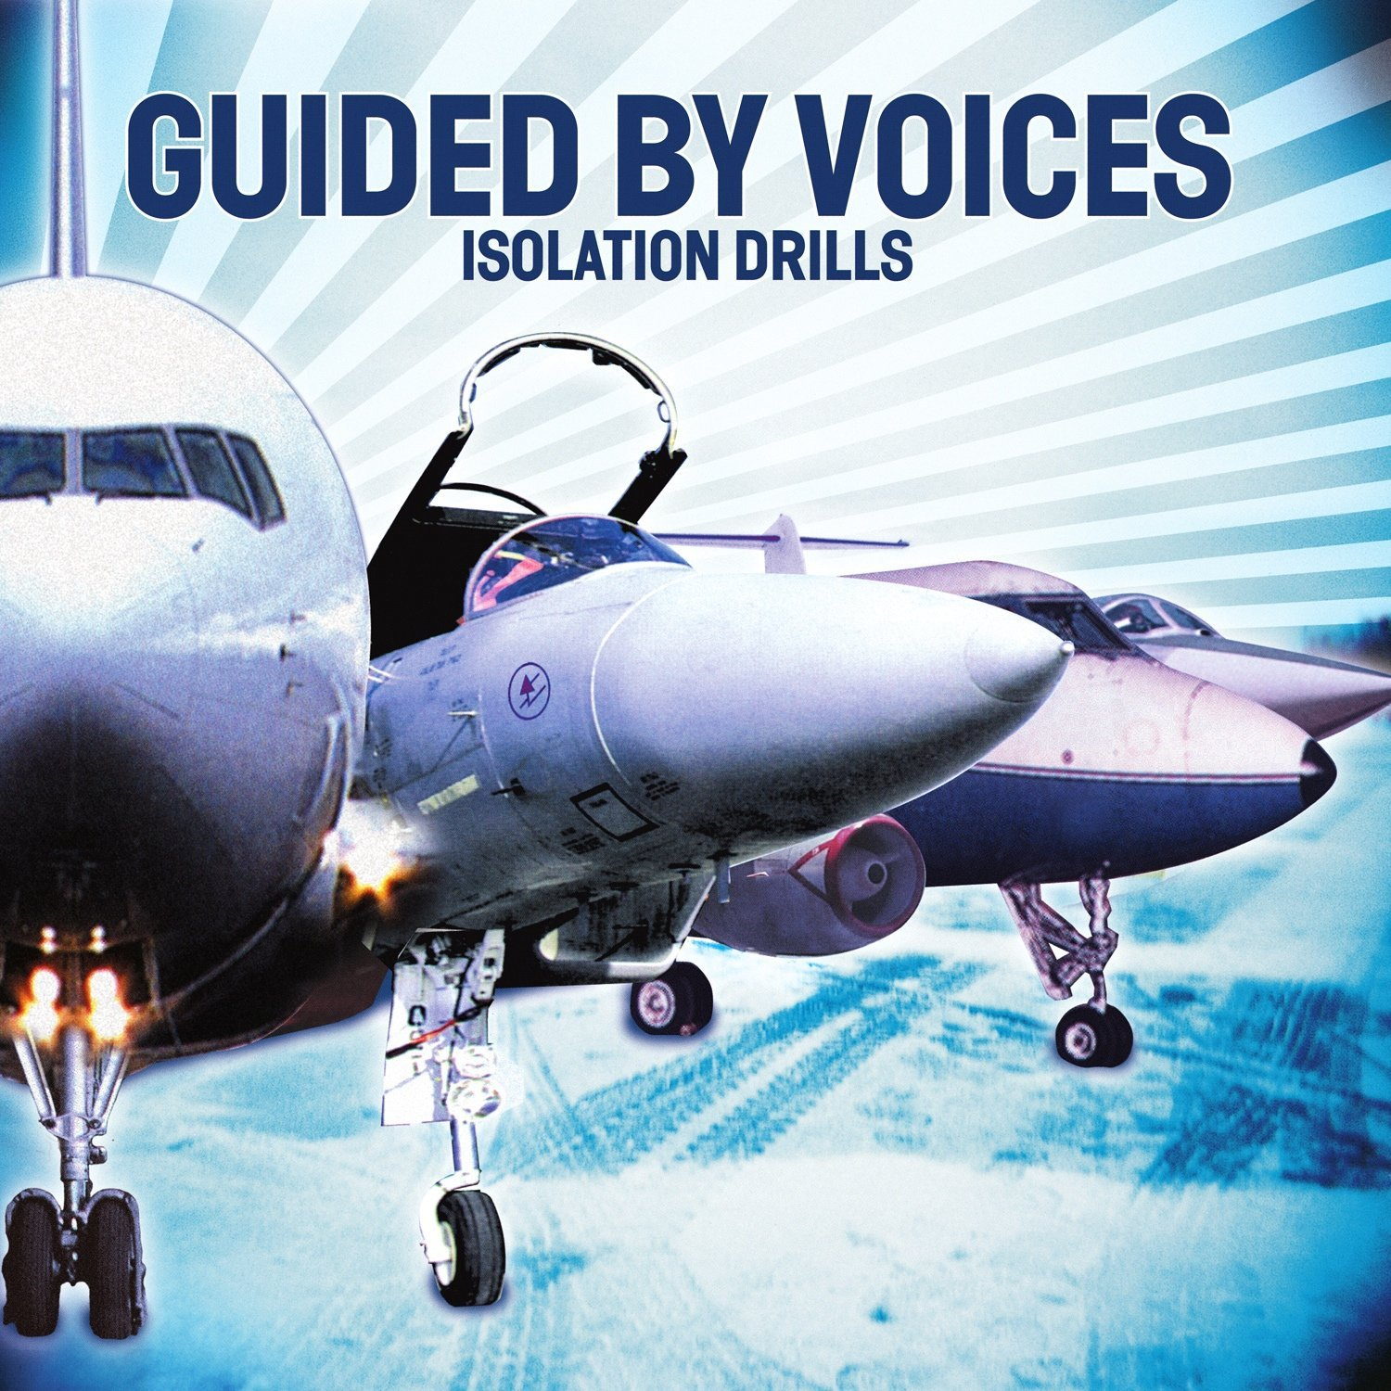
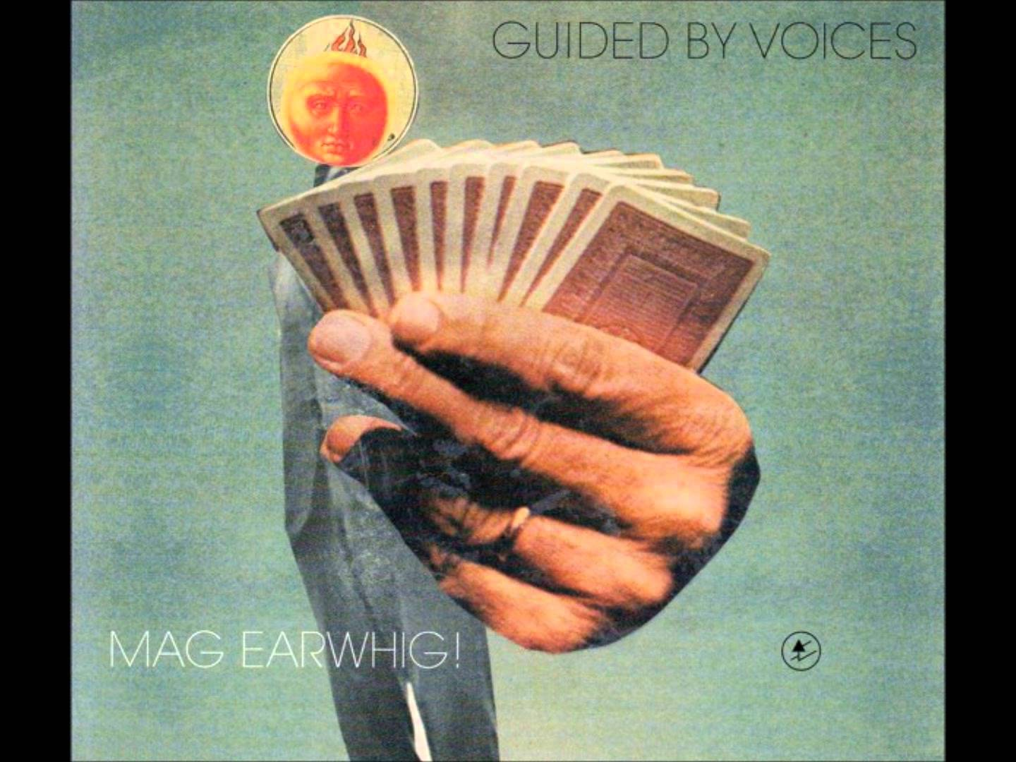
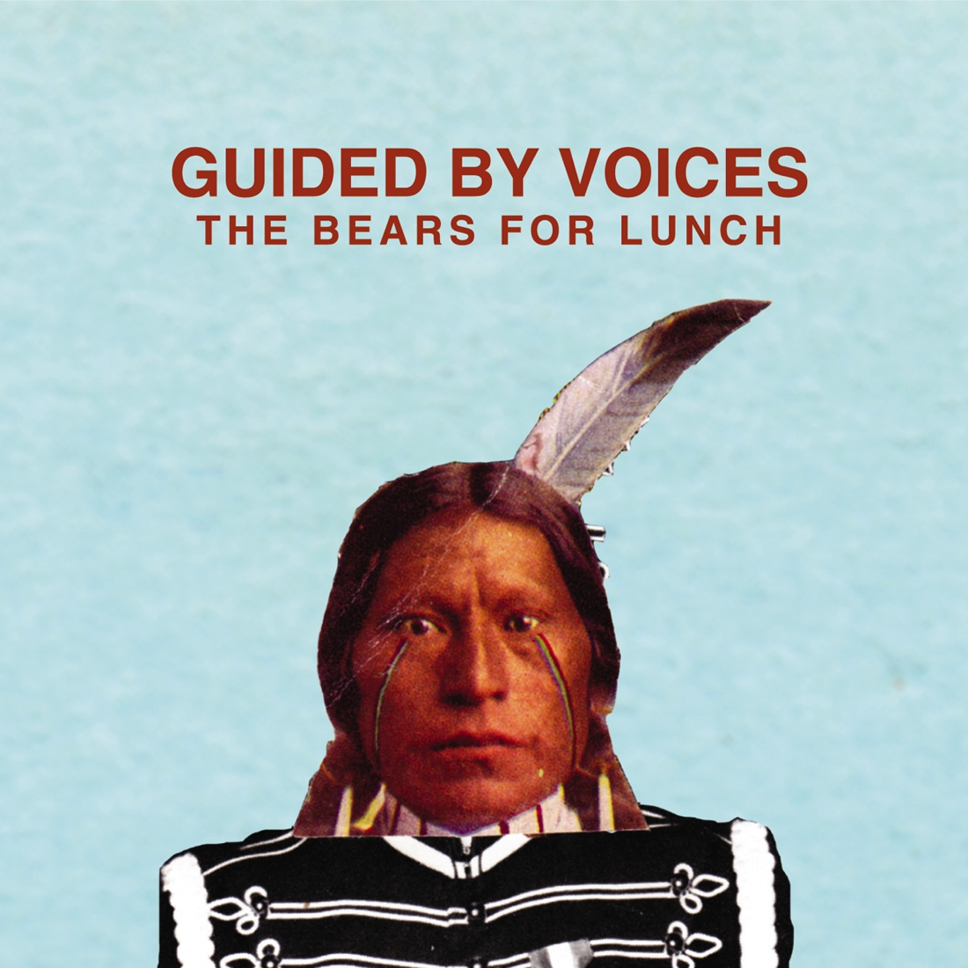
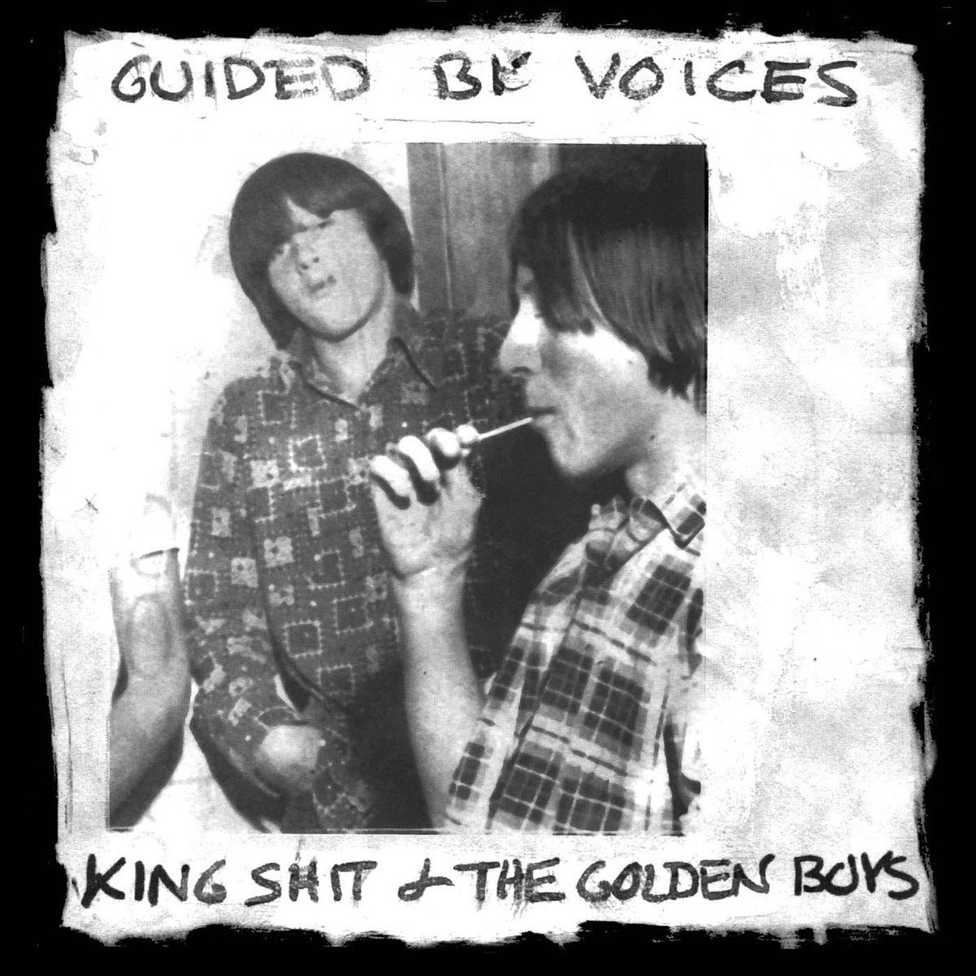
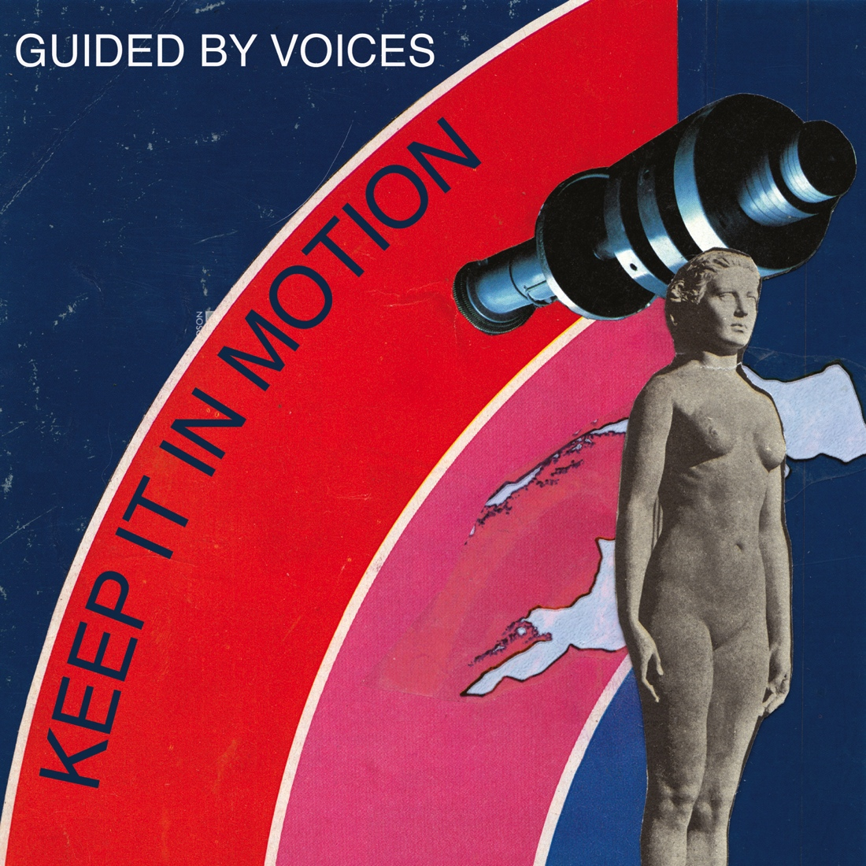
HISTORY OF COVERS

Slide 3
king shit and the golden boys c. 1990

Slide 4
alien lanes 1995

Slide 5
under the bushes under the stars (1997)

Slide 6
mag earwhig 1997

Slide 7
do the collapse 1999

Slide 8
isolation drills 2001

Slide 9
earthquake glue 2003

Slide 10
half smiles of the decomposed 2003

Slide 11
the bears for lunch 2012

Slide 12
keep it in motion 2012

Slide 13
class clown spots a UFO 2012

Slide 14
august by cake 2017

Slide 15
Mushroom Art
A compilation of Guided By Voices Songs
IDEAS & ROUGHS

Slide 16
IDEA numero one

Slide 17
Collage is a consistent element in GBV covers
I also notice there are a lot of “framing” devices used
Text is almost always Sans Serif
I wanted to use cropped elements from various GBV covers to create a new cover.

Slide 18
mock-up

Slide 19
idea numero two

Slide 20
I like the abbreviation GBV and feel that it offers some good graphic opportunity
I want to include images of Robert Pollard who is the one constant in the band throughout it’s long history
I want to keep a collaged feel
I want to limit the colour pallette

Slide 21
I like the idea of writing in tape to keep a DIY feel for the design

Slide 22
I like the idea that the letters will be transparent, making the image visible only under the “GBV”

Slide 23
I might use imagery like this: an iconic image of the front man (I also like the colour pallette)

Slide 24
Idea numero three
Again – collage, though there is a history of using amateur photography. I try to combine both ideas here.
More symbolic use of imagery.

Slide 25
I like the idea of an upside down man as a symbol for GBV’s penchant for flipping expectations about what a pop song can be, lyric construction and how a band should create, produce and release music.

Slide 26
I think that flipped man should be robert pollard (the mastermind behind GBV)

Slide 27
Such a vertical image suggests that the negative spaces on the sides of the square format should be occupied by the text. I like the idea that this grid paper be used as a background and that maybe the text is collaged buts corresponding to the gridded sections of the paper.

