Slide 1
Welcome to Art Class!
Ms.Dodge
Rooms 309 and 310
Art 8 & 10
Painting and Drawing 11 & 12
Art Careers 11
Advanced Placement Art and Design 12
Ceramics and Sculpture 9-12

Slide 2
Contact Information:
The fastest, easiest way for you or your family/guardians to contact me is to email:
School email: hdodge@vsb.bc.ca
Classroom email: 309dodge@gmail.com
I am also almost always at school by 8am, and in our classroom during breaks and lunch.
I teach Yearbook on Monday and Wednesday Afternoons 3:15-4:45 in Mr. Long’s Graphics Room 214.

Slide 3
Fees:
There are fees for art classes; the fees pay for the supplies you use throughout the year.
Fees are due By Friday, September 13, 2019
Payable by cash, cheque to Point Grey Secondary, or online.
Contact your grade counsellor if you cannot afford to pay your fees.
COURSE | FEE
Art 8 | $10
Art 10 | $25
Painting and Drawing 11 | $30
Painting and Drawing 12 | $30
Art Careers 11 | $35
AP Art 12 | $140
COURSE | FEE
Ceramics and Sculpture 9 | $25
Ceramics and Sculpture 10 | $25
Ceramics and Sculpture 11 | $30
Ceramics and Sculpture 12 | $30
Yearbook 11/12 | -

Slide 4
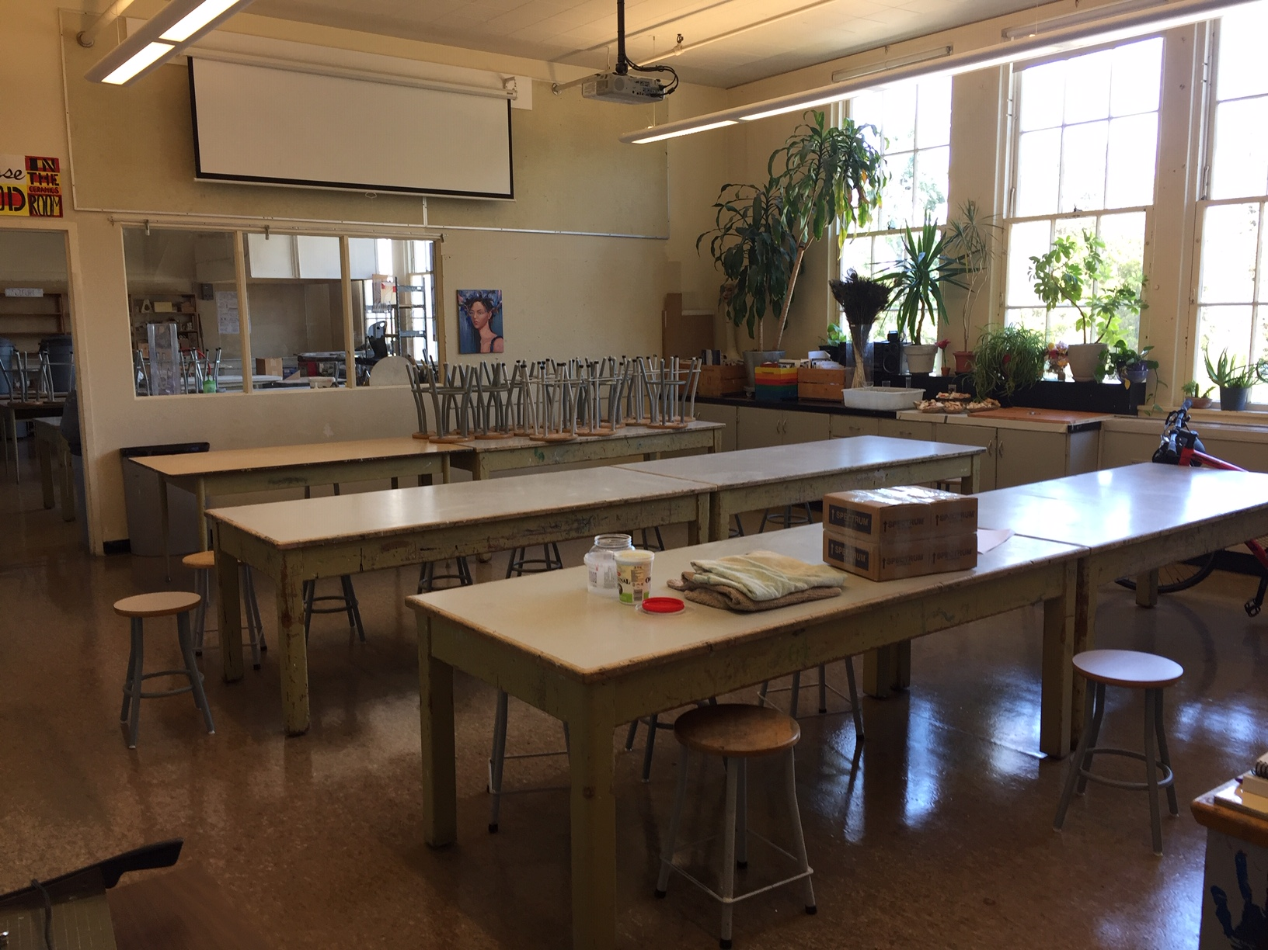
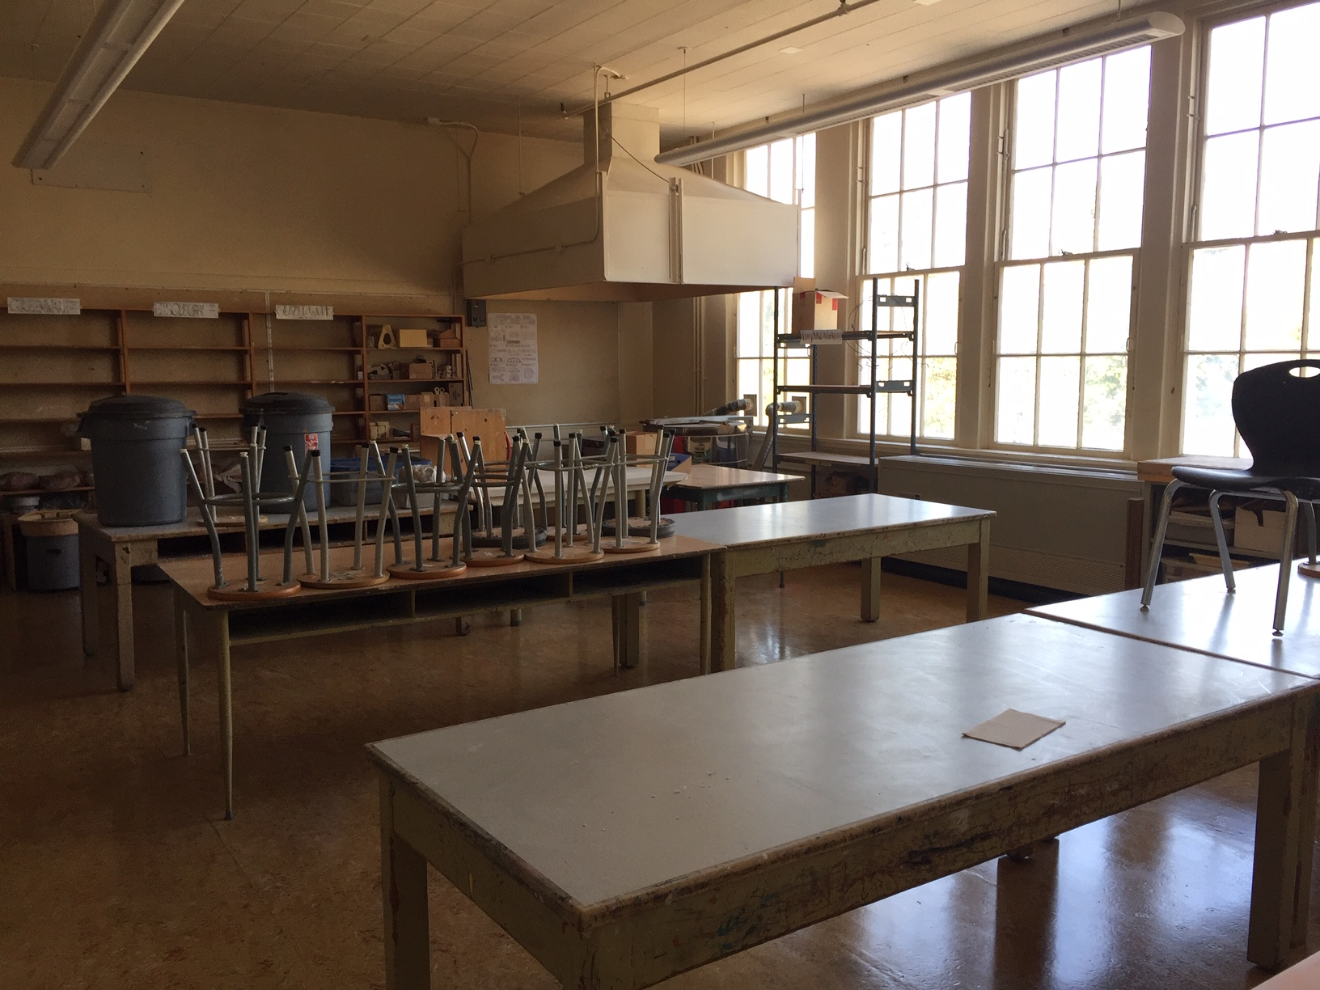
Locations:
Our class meets here in 309. Your class may be held in room 310, or you may be instructed to work in either room. Our classes are large and we will spread out at times.
309 is a general art room.
310 is a messy sculpture studio.
Please let me know if you need more space or quiet while working.

Slide 5
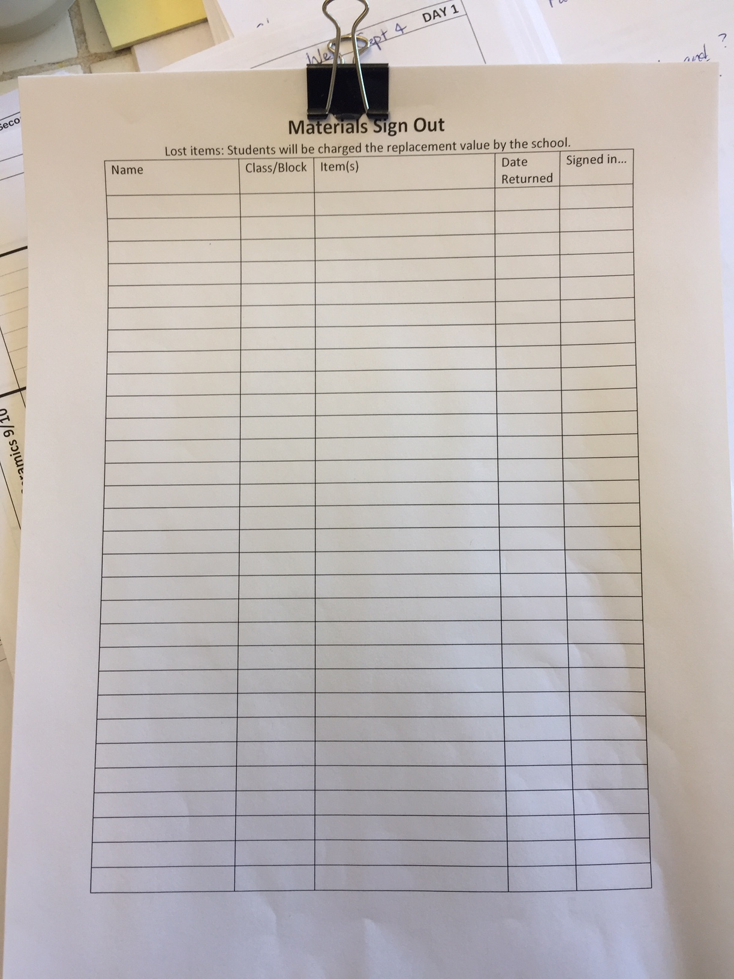
Materials:
All basic materials are provided in the classroom.
Sometimes you will be asked to find or buy some materials.
Let me know when something breaks or runs out so I know to replace it.
You may sign out some supplies to use at home: always see me to sign them out, and return them promptly. Items not signed back in by the end of the year will be charged to you.

Slide 6
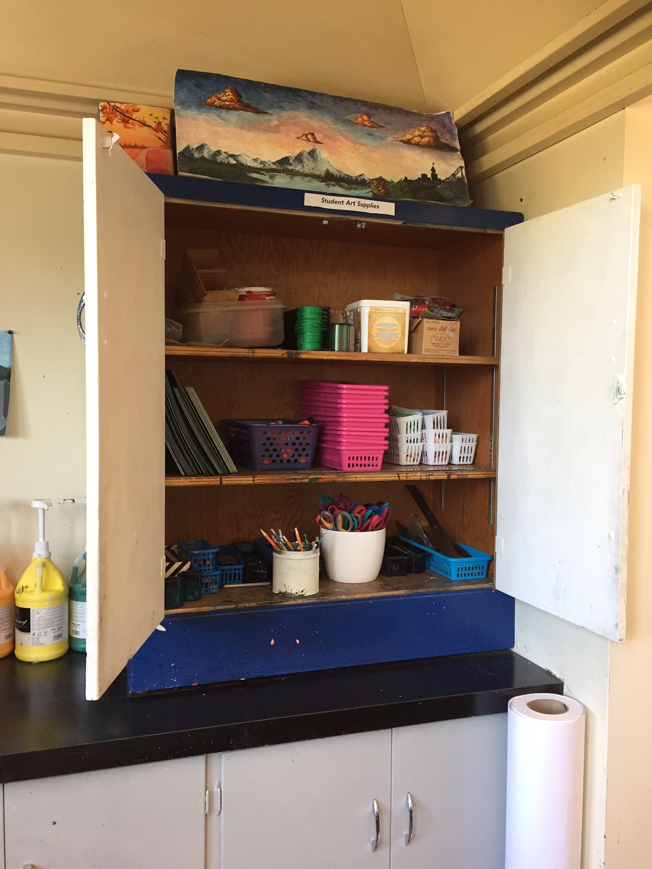
Student Art Supplies Cupboard
You may borrow supplies from the “Student Art Supplies” Cupboard without asking; please return them neatly at the end of class. (pencils, rulers, erasers, charcoal, scissors, glue sticks…)

Slide 7
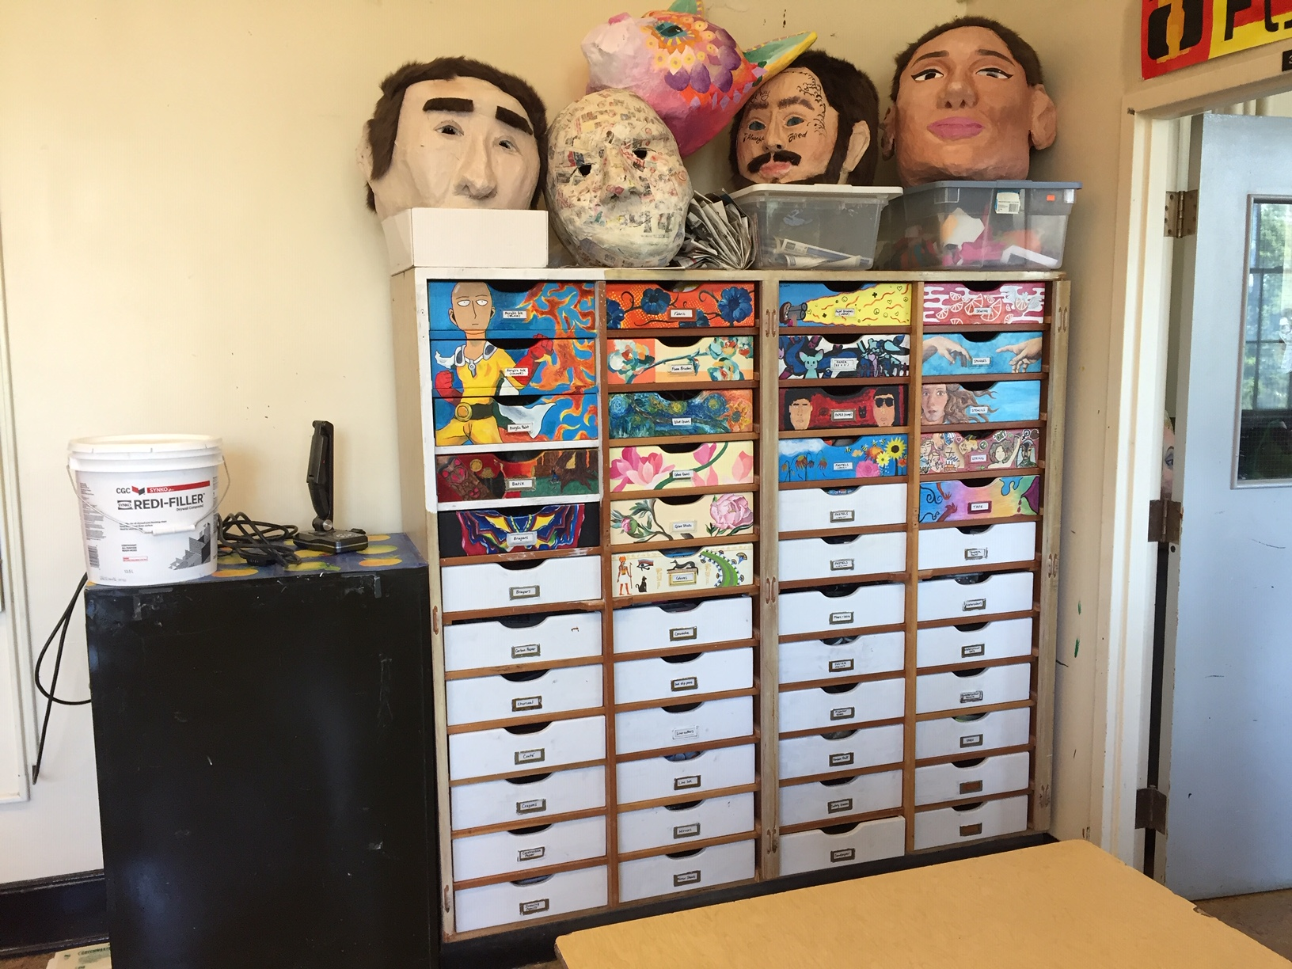
More on materials:
These drawers hold many materials; please ask for permission to access them, and be sure to return items to their proper drawer.

Slide 8
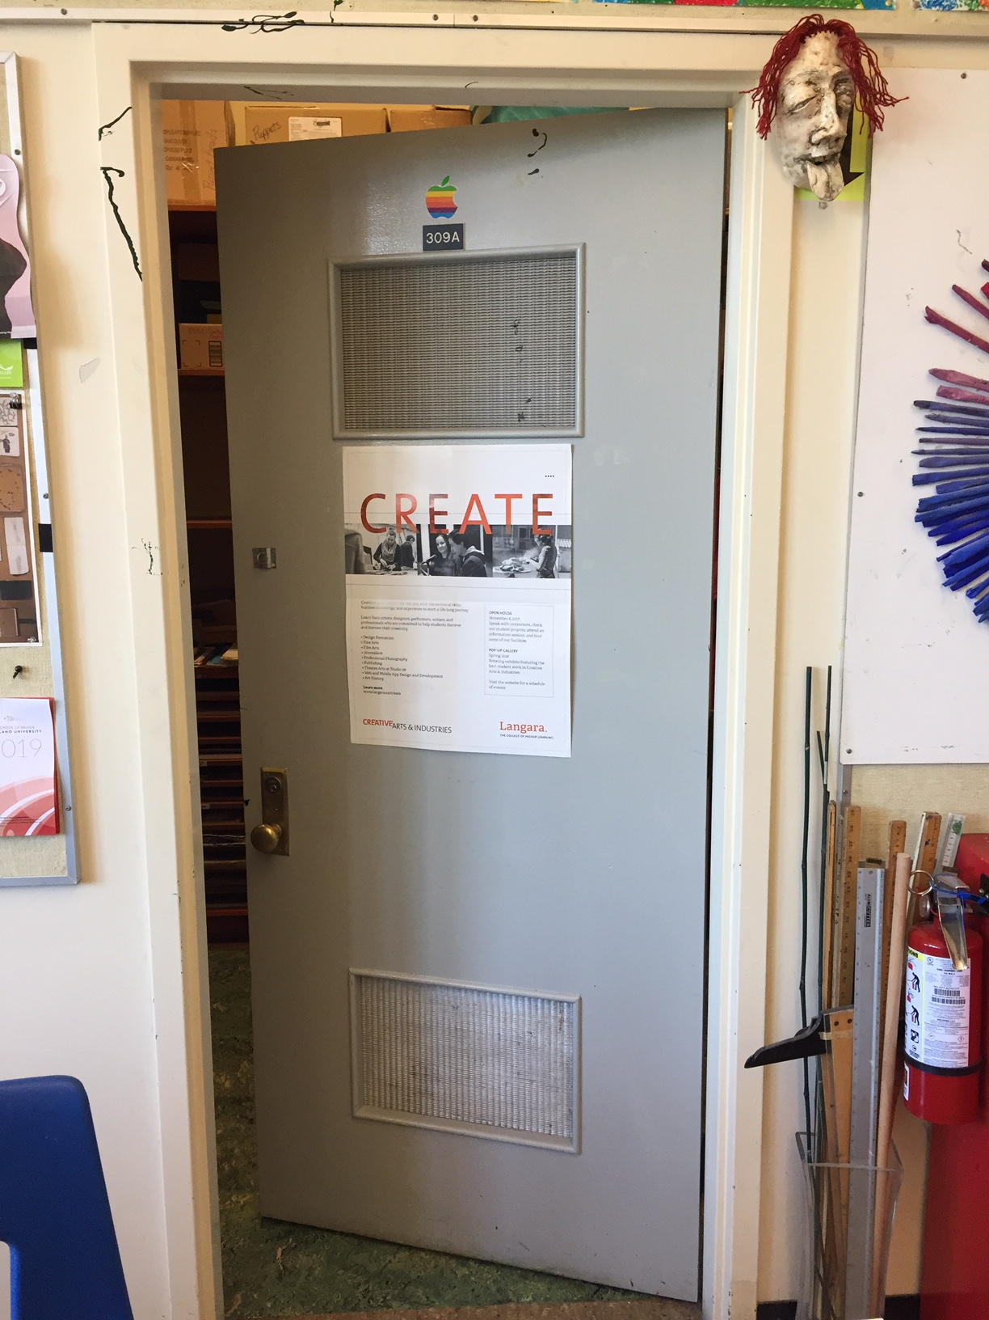
Teacher supply closet:
This room is off-limits to students. Please ask me if you need something.

Slide 9
Clean-up and Care of the Classroom:
This is your classroom.
Clean up after yourself.
Take care of equipment; it’s easier to make art with tools that are cared for.
Take responsibility for your mistakes (I won’t be angry, I promise!)
If you need more time to clean up, ask for an admin slip for your next class.
Students will be charged the cost for intentionally ruining supplies or repeatedly being careless in the classroom.

Slide 10
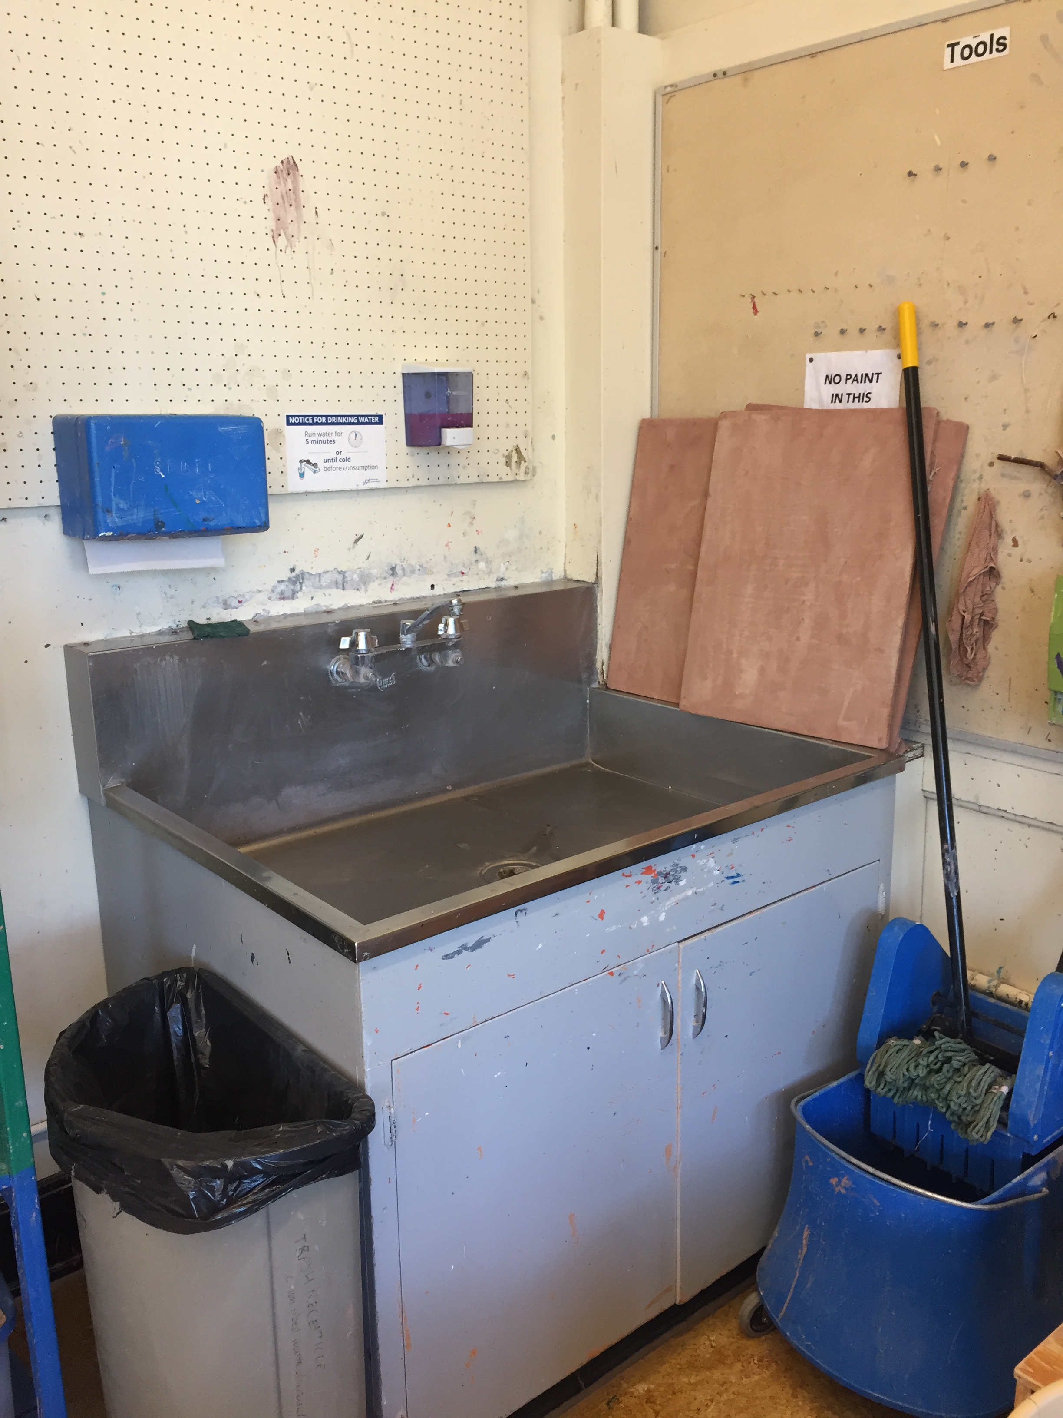
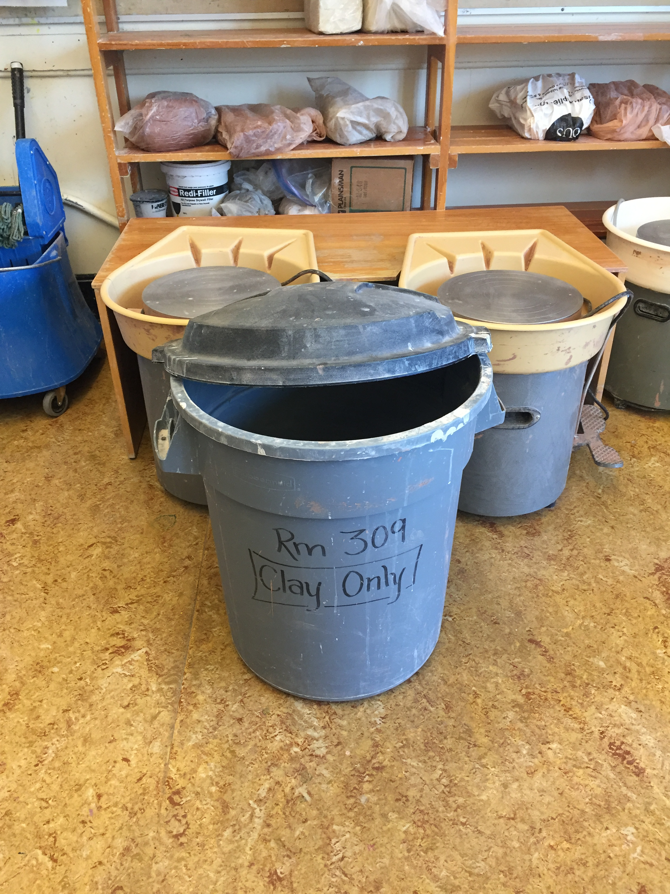
Ceramics Specific Information:
Do not put clay down the sink.
Do not throw clay in the garbage – it will be turned back into fresh clay.
Wash your tools.
Put dirty clay water in the slurry bucket.
Do not waste clay.
Clean up your messes – wipe surfaces with water.
This sink has a clay trap, so no paint here, please!
Slurry bucket for washing water, really wet clay from thowing, and bone dry clay.

Slide 11
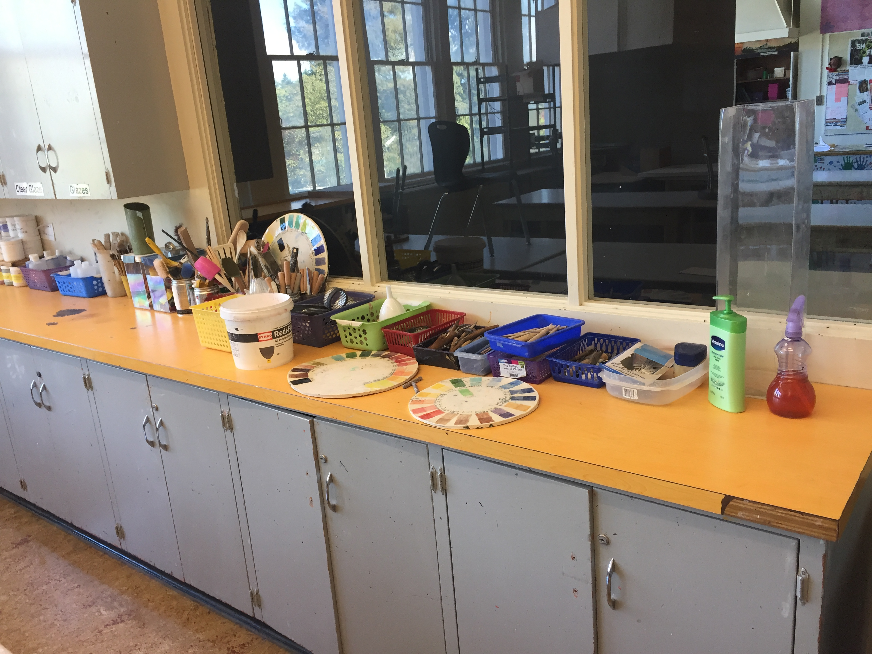
Clean Up Clay with WATER!
Wash your table.
Wipe off your canvas bat with a wet rag or sponge
Wipe up spills on the floor with a wet paper towel, or use the mop.
Wash tools and return them to the baskets.
This is where you will find the clay tools!

Slide 12
Attendance:
I will take attendance at the beginning of the block. If you leave class without permission before the bell, I will mark you absent.
Please let me know in advance if you know you will be away.
Please bring notes for excused absences.
Please arrange to make up missed time with me during tutorials, breaks, and after school.
Seniors with a free block MAY ask permission to work in the classroom during other blocks.

Slide 13
Websites:
This year I will be trying to put most handouts and information online rather than printing copies.
You will find your syllabi, assignments, marking sheets, and most class presentations on the art website under your class name. Bookmark:
https://pointgreydesign.weebly.com/
Art Careers 11 and AP Art 12 will work with an Edmodo this year, and will receive personal invitations to the website.

Slide 14
Sketchbooks:
$5
Grades 9-12 are required to use a sketchbook in class. It should be about 9X12” and have good quality paper. (Used sketchbooks are fine.)
Your name/block must be VISIBLY on the spine or front of your book.
I will have some sketchbooks for sale in the classroom:
9X12 Opus Hardcover sketchbooks $7
9x12 Opus Essential 48-page Soft-cover Sketchbooks $5
BRING IT TO EVERY CLASS!
Grade 8s get these
$7

Slide 15
New York!
This is a New York Trip Year!!! (Wahooo!)
Students in Grade 11 or 12 AND enrolled in any art, photo, graphics or yearbook course can apply to go to NYC in March with Mr. Long and I. Listen for announcements – space is limited!
The following trips will be in Spring 2022, then Spring 2024.

Slide 16
Portfolios and Art School
Students interested in preparing a portfolio to apply for art schools in the fall of their senior year should begin discussing their intentions and work with Ms. Dodge and/or Mr. Long in grades 10, 11 and 12.
Please feel free to talk to me or ask for help at any time!

Slide 17
Homework:
Please write me a short note to introduce yourself. Include:
The name you usually use, and which pronouns you use (she/they/he/etc.)
Why you’re taking an art class
What kinds of art you like best
A goal for this term’s art class
This assignment is due at the beginning of next class.

Slide 18
Questions/Comments/Issues/Need help?
Please talk to me before or after class, or send me an email. I work closely with counsellors and admin to make sure that your time here is healthy and productive.
AND Have FUN! ☺

